Slide 1
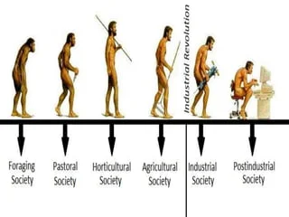
Social evolution/
Evolution of Society

Slide 2
MacIver and Page defined society as, "It is the web of social relationships.“
Society

Slide 3
A society is a collection of individuals united by certain relations or mode of behavior which mark them off from others who do not enter into these relations or who differ from them in behavior”. - Morris Ginsberg.
Society

Slide 4
Society involves Likeness: Without the sense of likeness there could be no mutual recognition of "belonging together" and, therefore, no society.
Society

Slide 5
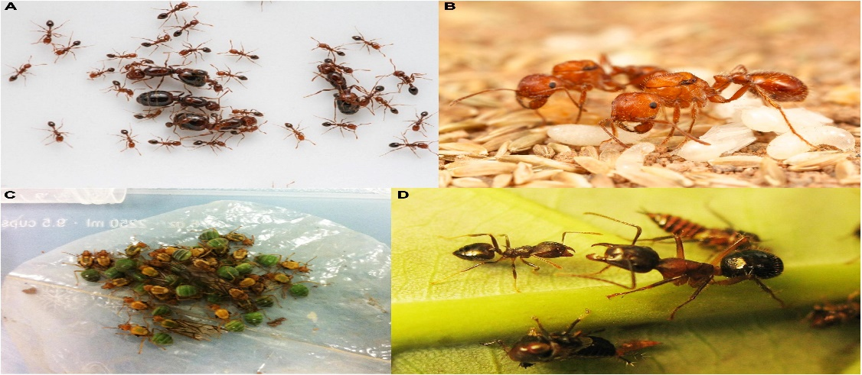
Society
Society involves Difference: Though likeness serves as the basis, society also depends on differences. If people were all alike, their social relationships would be as limited as those of the biological organisms like ants and bees.

Slide 6

Society
Inter-dependence in the Society: In addition to likeness, interdependence based on cooperation is yet another essential element to constitute the society.

Slide 7

Society
Multiplicity of Relationships: Society consists of numerous social relationships, which may be hundreds or thousands of types.

Slide 8
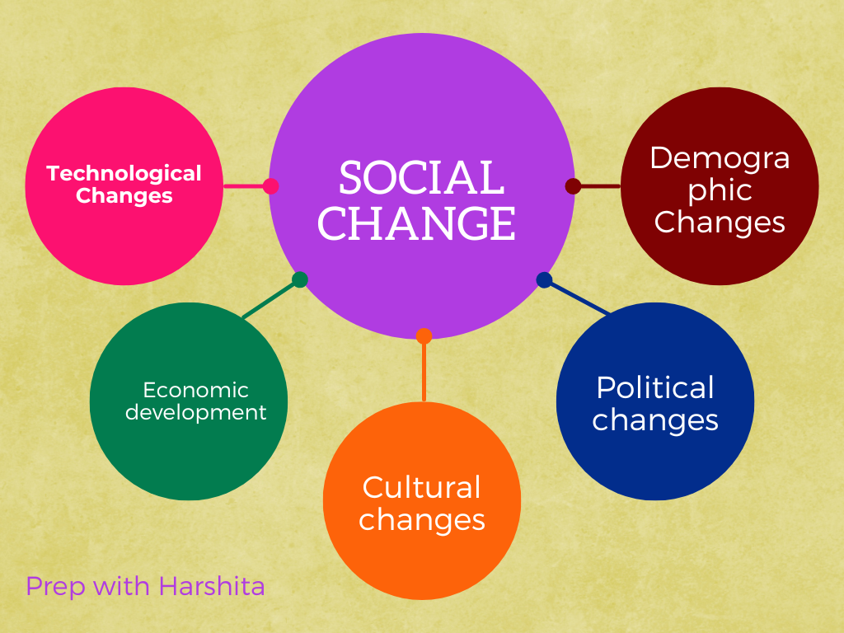
Society
Society is dynamic:
Society is not at all a static phenomenon, but it is a dynamic entity. Society is subject to constant changes. Social change has occurred in all societies and at all times.

Slide 9
Changes occurred
Human beings have existed on earth for less than half a million years or so.
Agriculture, the necessary basis of fixed settlements, is much more recent, being just 12,000 years old.
Large-scale human civilizations date back no more than 6,000 years.

Slide 10
In general, the term evolution represents the process of gradual development.
This is the process through which simple things, over the time, become complex.
Evolution

Slide 11
The two evolutionists who were regarded as anthropologists are the British anthropologist E. B. Tylor and the American anthropologist L. H. Morgan.
They are considered as the founders of the nineteenth century evolutionism.
Evolutionist in
Anthropology

Slide 12
E. B. Tylor’s famous contribution titled ‘Primitive Culture’ was published in 1871
E. B. Tylor

Slide 13
Sources of Charles Tylor’s work
If we concentrate on the world history of that point of time, we shall find out that in that particular era, English people were mainly concentrating on expanding their political territory through massive colonialism.

Slide 14
Sources of Charles Tylor’s work
As a result, many people like the travelers, explorers, businessmen, missionaries and several officials of the Government were visiting the different parts of the world.
Tylor took the help of these people in preparing his thoughts and writings

Slide 15
Evolution by Tylor
According to him, a society’s evolution is unidirectional and it passes through three different stages one after another.

Slide 16
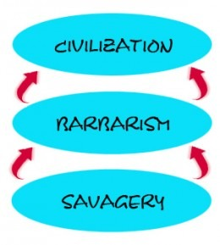
Three stages of evolution

Slide 17
Later anthropologists Lewis Henry Morgan gave a detailed exposition of it in his 1877 book Ancient Society.
Three stages of evolution

Slide 18
Savagery (Lower, Middle, Upper)
Barbarism (Lower, Middle, Upper)
Civilization (None)
Division of Three stages of evolution

Slide 19
It was the time before fire
People used to collect fruits and nuts
Man still lived in his original habitat, in tropical or subtropical forests, and was partially at least a tree-dweller.
Lower Savagery
Time period - Paleolithic (ca. 2 million years ago to 12,000 years)

Slide 20

Promiscuous bands
People practiced Indiscriminate mating
Social and economic system was Communistic.
The development of articulate speech is the main result of this period
Lower Savagery
Time period - Paleolithic (ca. 2 million years ago to 12,000 ya)

Slide 21
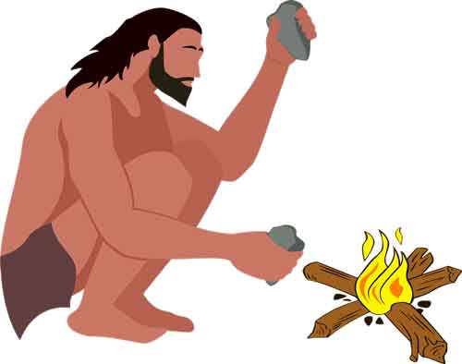
Middle Savagery
Time period - Paleolithic (ca. 2 million years ago to 12,000 years)
Begins with the utilization of fish for food (including crabs, mussels, and other aquatic animals), and with the use of fire. The two are complementary, since fish becomes edible only by the use of fire.

Slide 22
Human now became independent of climate and locality
Discovered new kinds of food: roots and tubers, for instance, were baked in hot ashes or in ground ovens.
Middle Savagery
Time period - Paleolithic (ca. 2 million years ago to 12,000 ya

Slide 23
Middle Savagery
Time period - Paleolithic (ca. 2 million years ago to 12,000 years)
Continual uncertainty of food supplies, cannibalism seems to have arisen, and was practiced from now onwards for a long time.
The Australian aborigines and many of the Polynesians are still in this middle stage of savagery today (when the book Ancient Society was written).

Slide 24
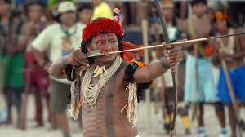
The bow and arrow was introduced.
Upper Savagery
Time period - Paleolithic (ca. 2 million years ago to 12,000 ya

Slide 25
Settlement in villages
Wooden vessels and utensils, finger-weaving (without looms); plaited baskets of bast or osier; sharpened (neolithic) stone tools.
Example, Indians of northwest America
Upper Savagery
Time period - Paleolithic (ca. 2 million years ago to 12,000 ya

Slide 26
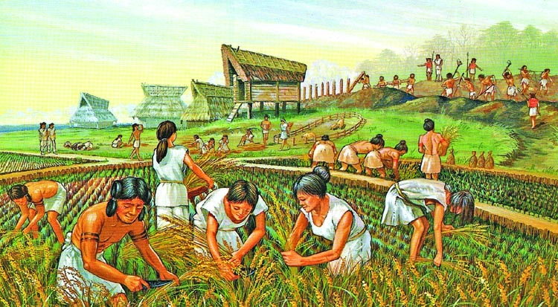
Lower
Barbarism
(Neolithic era around 12000 years ago)
Beginning of Plant domestication
Invention of pottery
The first pots originated from the habit of covering baskets or wooden vessels with clay to make them fireproof

Slide 27
Lower
Barbarism
Clan was matrilineal,
Communal ownership
Clan exogamy

Slide 28
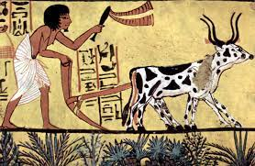
Animal domestication
The Indians at the lower stage of barbarism (comprising all the tribes living east of the Mississippi) were already practicing some horticulture of maize, and possibly also of gourds, melons, and other garden plants, from which they obtained a very considerable part of their food.
Middle
Barbarism

Slide 29
Middle
Barbarism
The plentiful supply of milk and meat and especially the beneficial effect of these foods on the growth of the children account perhaps for the superior development of the Aryan and Semitic races.
Cannibalism ended from most of the societies
Patrilineal clans;
individual ownership, polygamy

Slide 30
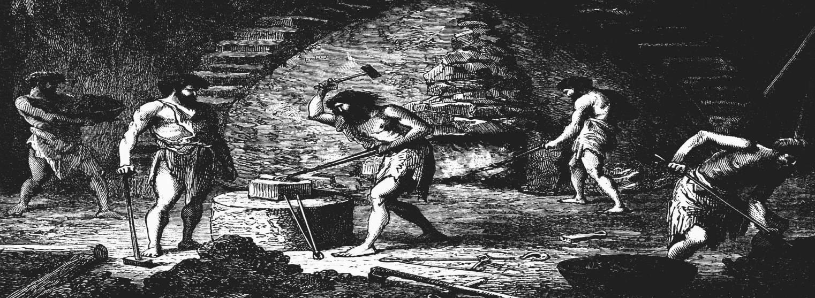
Traits- Eventually in certain areas a Bronze Age and/or Iron Age developed as Neolithic cultures added the use of metal.
Upper
Barbarism

Slide 31
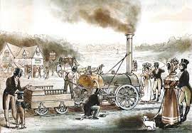
Civilization (ca. 5000/6000 years ago) Traits include intensive agriculture, industrialization, capitalism, social stratification, political state, full-time occupational specialists.
Civilization

Slide 32
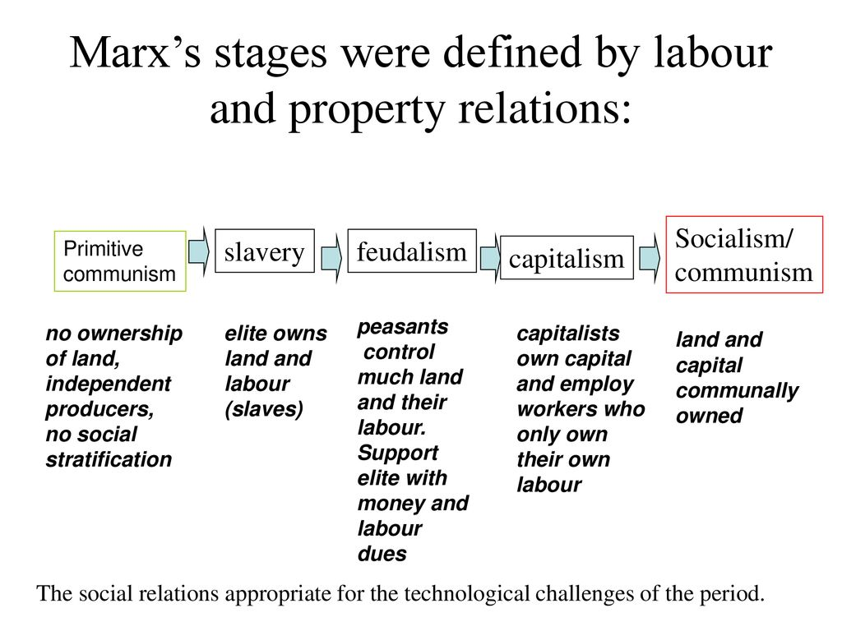
Civilization

Slide 33
Thank You

